Slide 1
Cluster Finding
Using Deep Learning Methods
(7nd feb 2023)

Slide 2
Introduction
Instance Segmentation is a special form of image segmentation that deals with detecting instances of objects and demarcating their boundaries.
Semantic Segmentation + Individual Instance Separation

Slide 3
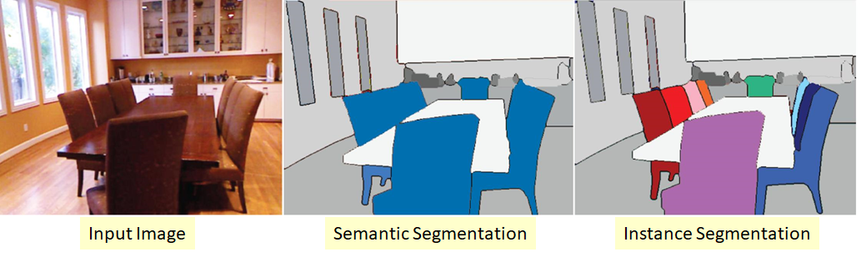
Introduction
Task 1: Semantic Segmentation:
Clustering parts of an image together which belong to the same object class.
Task 2: Area to Instance:
Separating detected regions of interest into individual components

Slide 4
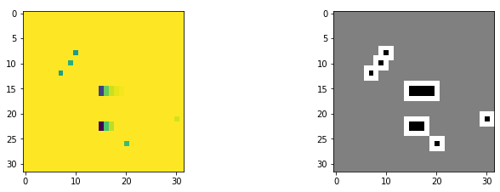
Formulating Strategy: Task 1
All viable deep learning techniques for similar task require labeled data. [1][2][3]
Compressed ENET Model [3] seems promising to help us achieve Task 1.
Use Trimaps to deal with overlapping clusters.

Slide 5
Formulating Strategy: Task 2
Classical Approach: MVP
Select Sure Background
Select Sure Foreground
Apply Connected Components (FPGA Alternative) [5]
W/O Border Separation: END
With Border Separation: Assign border to either Cluster
Learning Based:
Train a model to label the predicted segments. Would require Labeled data from Classical Approach above.
Existing direct methods [4] point towards using Mask RCNNs: A computationally expensive way of getting the task done even on a GPU.

Slide 6
Current Progress
Completed End-End Pipeline iteration 1
Training performed using 3000 images
Test set with 1000 images
Model Architecture used: UNET model (Complex Model)
7,760,931 parameters
Visual Inference Results available

Slide 7
Further Steps
Train Model with more data
Generate Inference Results
Optimize Model: Towards ENET and Q-KERAS
Repeat Through 3-5 till optimum model with acceptable params

Slide 8
References
Face Detection: https://scholarworks.calstate.edu/downloads/n009w764c
Vehicle Detection: https://upcommons.upc.edu/bitstream/handle/2117/180648/2238-3D-vehicle-detection-on-an-FPGA-from-LiDAR-point-clouds%20(1).pdf
FPGA semantic segmentation: https://iopscience.iop.org/article/10.1088/2632-2153/ac9cb5/meta
FPGA CCL: https://ieeexplore.ieee.org/document/4762381

Slide 9
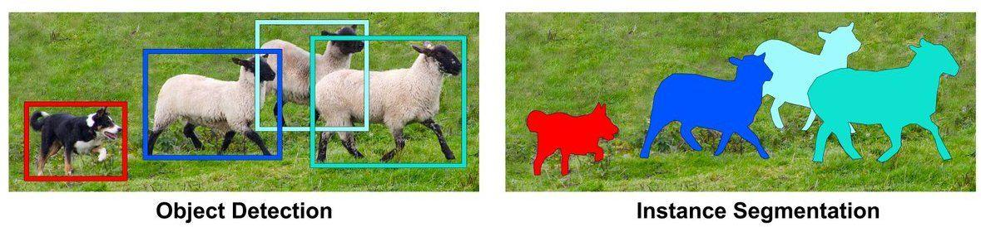
Extras: Another Way to go
Another Approach:
Do object bounding box detection first
Then perform semantic segmentation on each if the detected object
Might be computationally expensive too!

